Slide 1
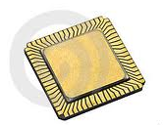

ADC 數位類比轉換器
【微處理機實習】
虎尾科技大學 資訊工程系
陳國益

Slide 2
大綱
瞭解 ADC(類比轉數位) 的原理
瞭解相關暫存器的使用

Slide 3

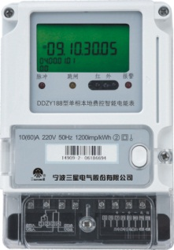
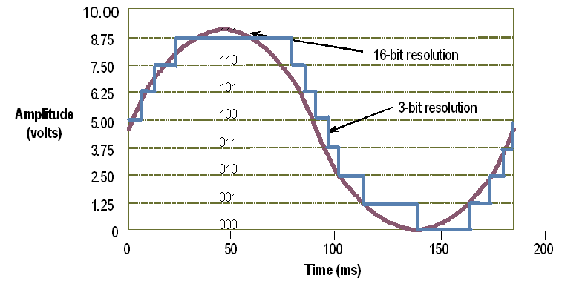
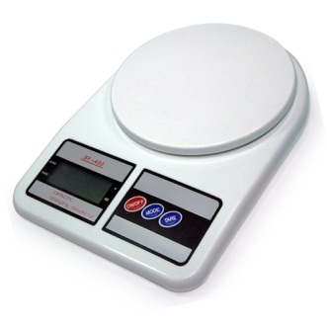
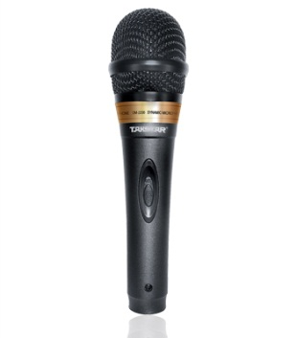
NUC140 : 8-channel 12-bit 800KSPS ADC
智能電表(smart meter) 採用16/24-bit ADC
電子秤採用16/24-bit ADC
Audio : 96KHz, 24-bit Stereo ADC

Slide 4

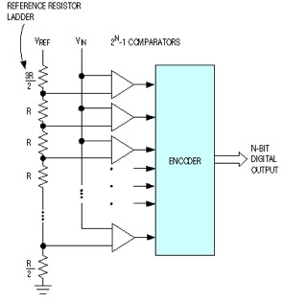
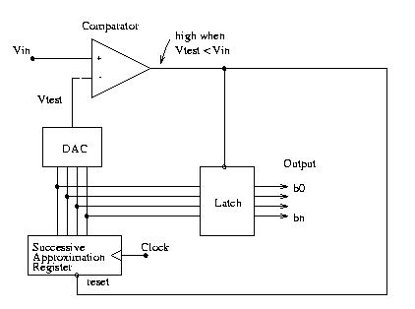
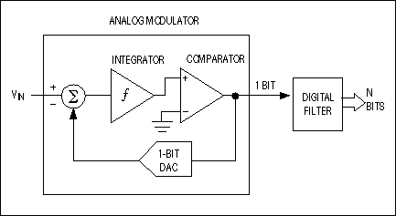
直接轉換式 : Direct-Conversion ADC
逐次逼近式 : SAR (Successive Approximation Register) ADC
三角積分式 : ΔΣ ADC (Sigma-Delta ADC)
Sigma-Delta ADC
SAR ADC
Successive Approximation Register
Direct-Conversion ADC

Slide 5

12-bit SAR ADC
Analog input voltage range:
  0~Vref (Max to 5.0V).
Operation voltage:
  AVDD=3.0V~5.5V;
Input channel:
  Up to 8 single-end analog input channels
  4 pairs of differential analog input channel.
Up to 800KHz conversion rate.
The maximum ADC operating frequency is 16M Hz
Three operation modes
  Single mode
  Single-cycle mode
  Continuous scan mode

Slide 6

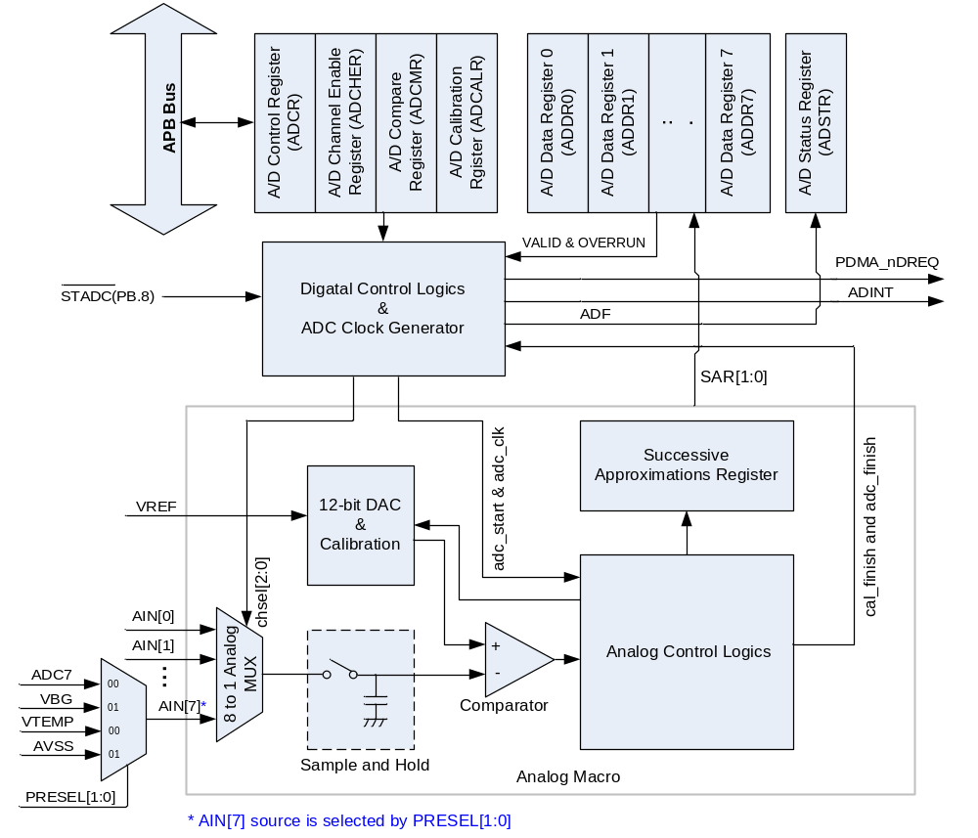
ADC Configuration Control
Conversion Results
ADC PDMA Request
External Trigger Pin
4 options: falling/rising /high/low
Reference Voltage Input
ADC Interrupt Request
Channel Selection

Slide 7

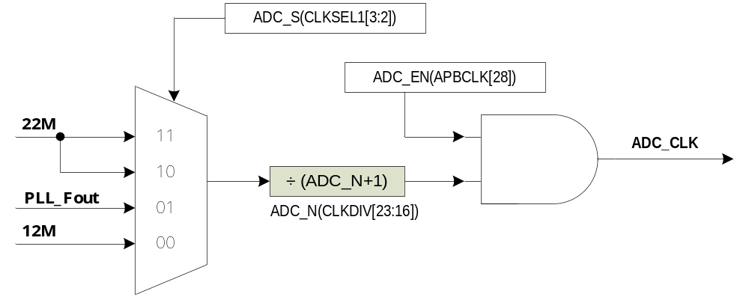

The maximum ADC clock frequency is 16MHz
The ADC clock frequency = (ADC clock source frequency) / (ADC_N+1);
  ADC_N is an 8-bit pre-scaler

Slide 8

The ADC input pins share with GPIO port A
The ADC input pins must be configured in input type
Single-end input mode
  Channel 0 ~ Channel 7 share with GPA0~GPA7
Differential input mode
  Channel 0 ~ Channel 3
  Differential input channels are the paired channels
Differential input paired channel | Single-end input channel
0 | 0 | 1
1 | 2 | 3
2 | 4 | 5
3 | 6 | 7

Slide 9

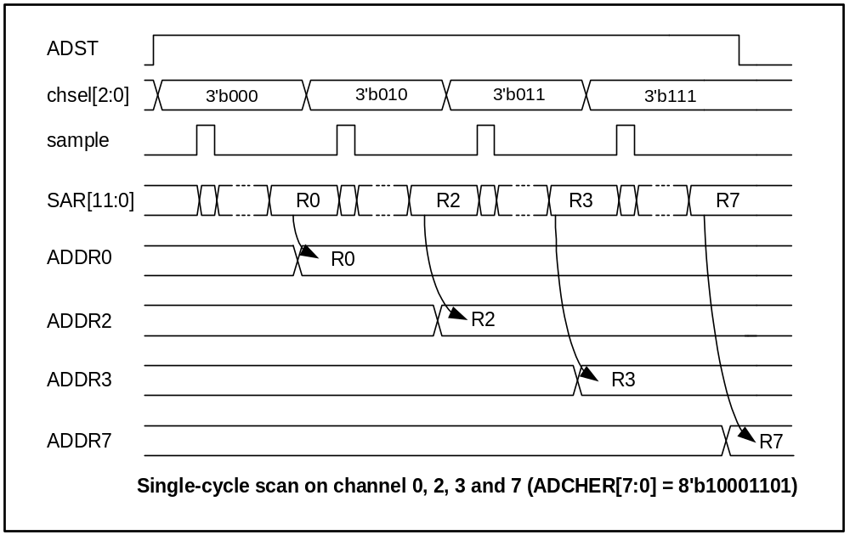
Channel0
Channel2
Channel3
Channel7

Slide 10

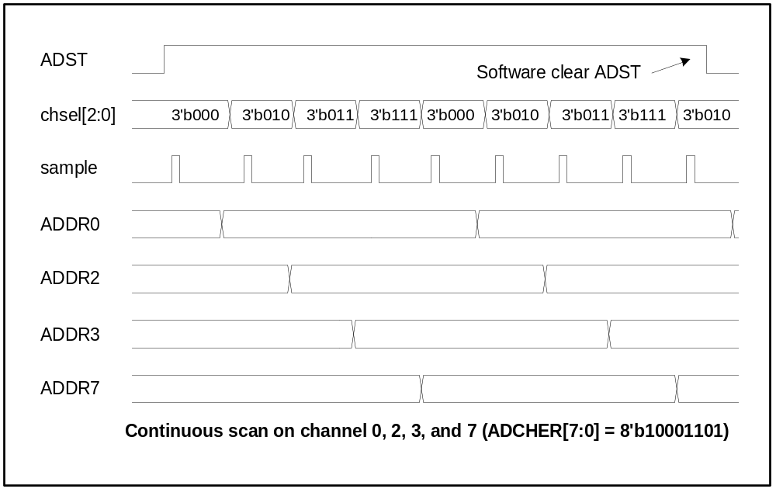
Channel0
Channel2
Channel3
Channel7
Channel0
Channel2

Slide 11

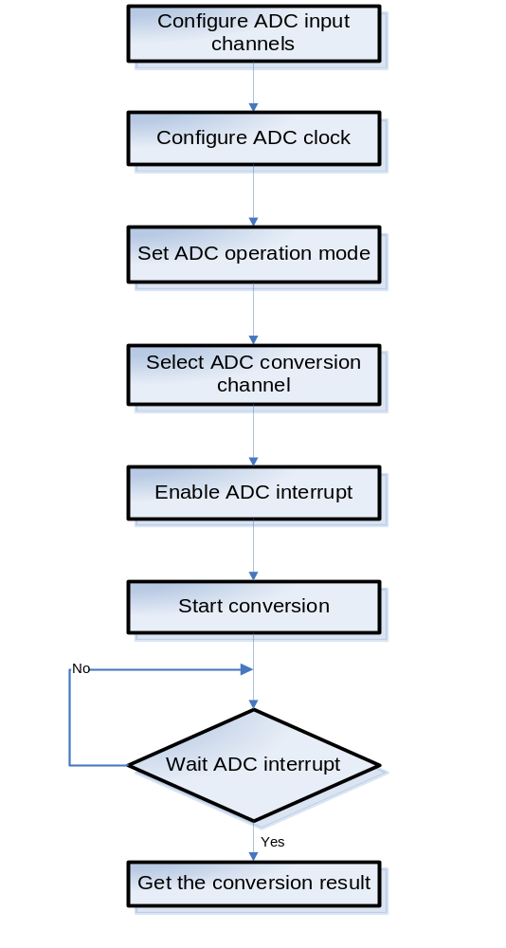

Slide 12

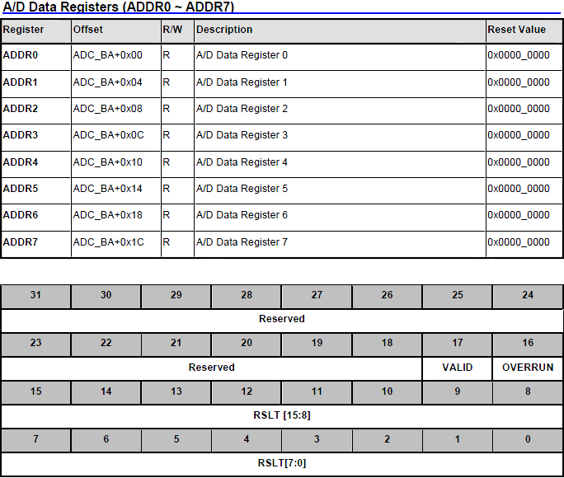

Slide 13

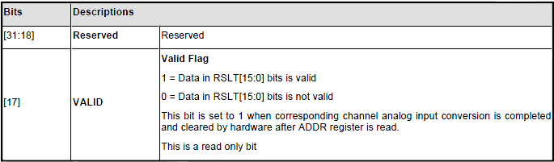
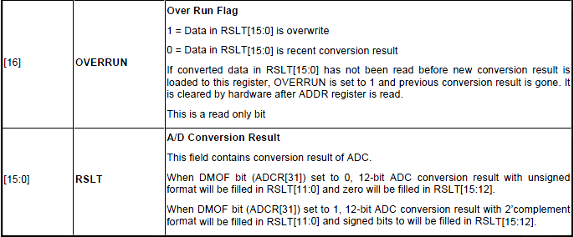

Slide 14


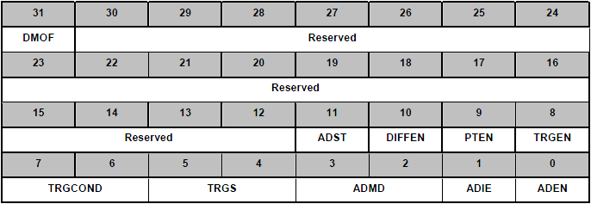
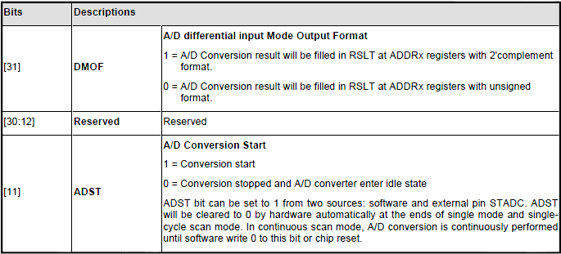

Slide 15

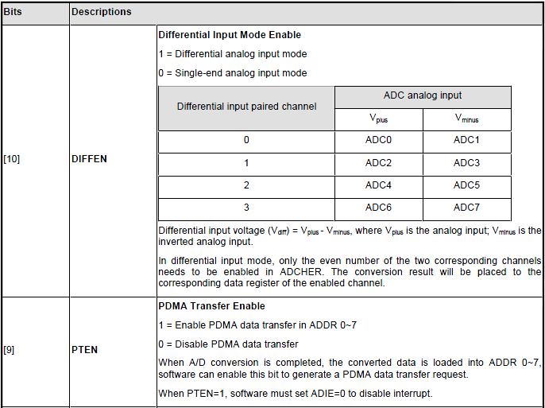
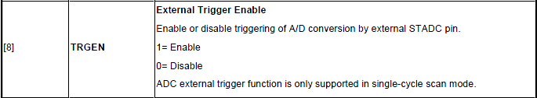

Slide 16
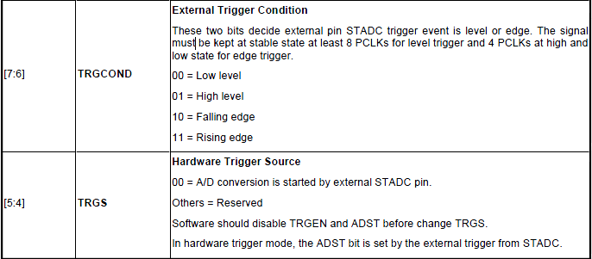

Slide 17
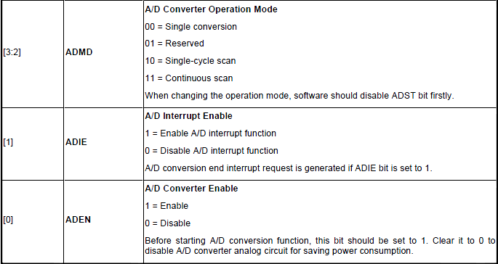

Slide 18


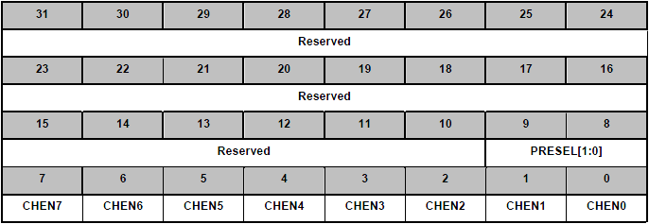
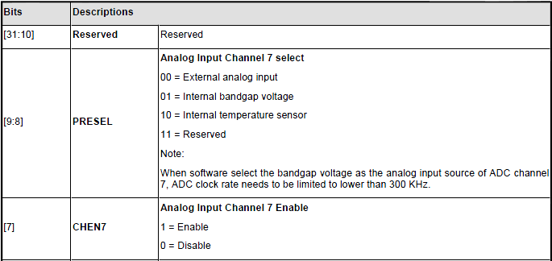

Slide 19

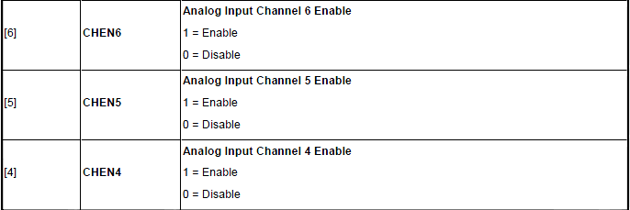
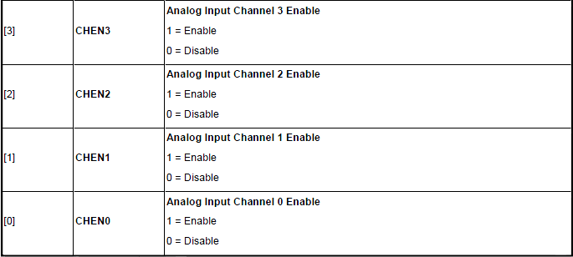

Slide 20

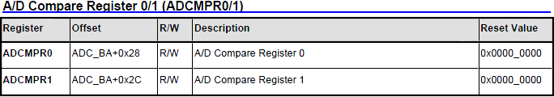
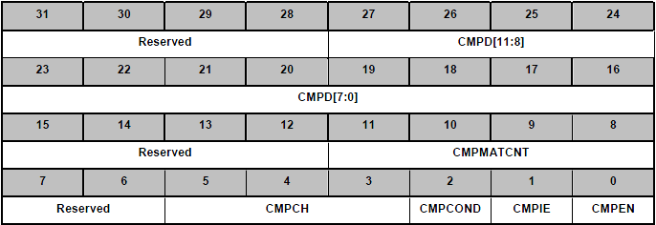
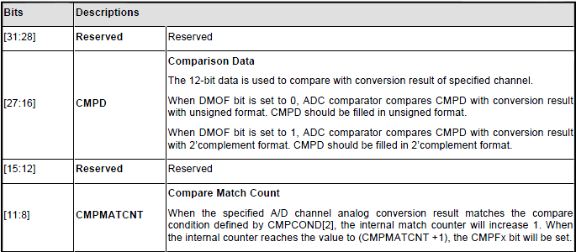

Slide 21

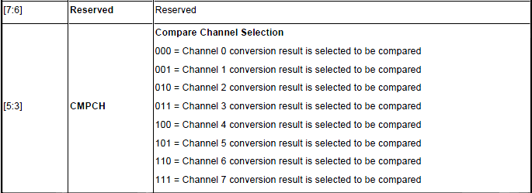

Slide 22
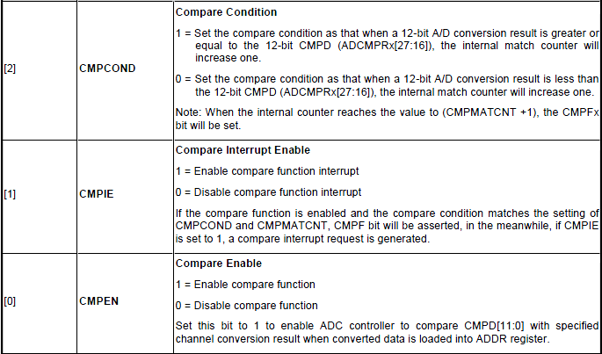

Slide 23


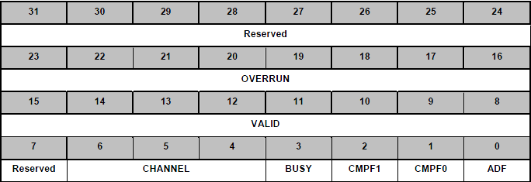
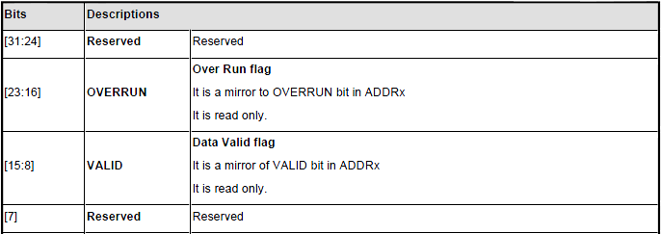

Slide 24

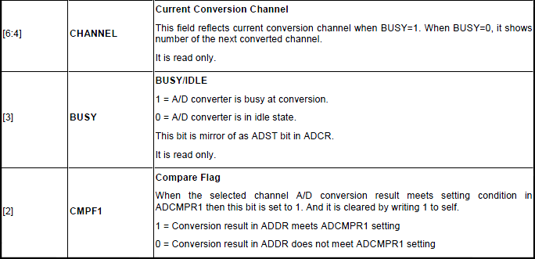
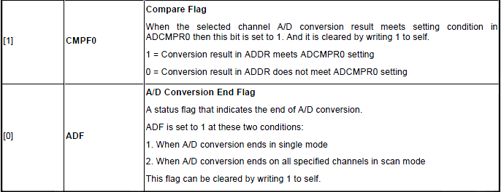

Slide 25


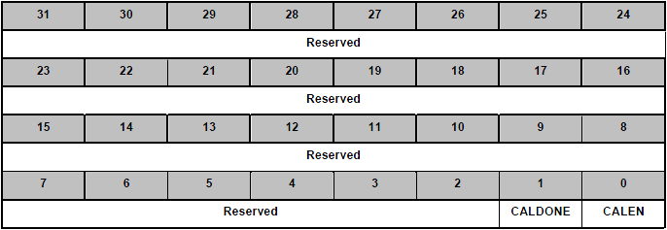
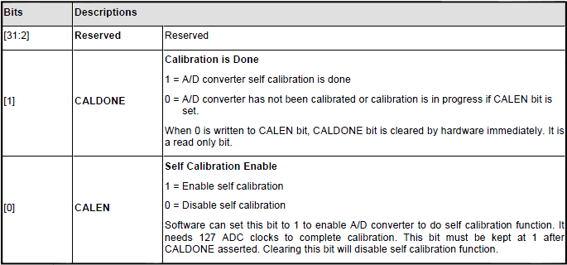

Slide 26

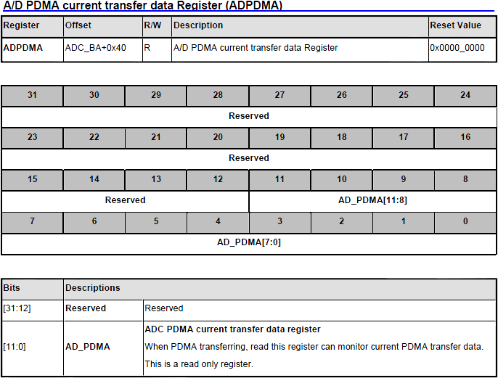

Slide 27
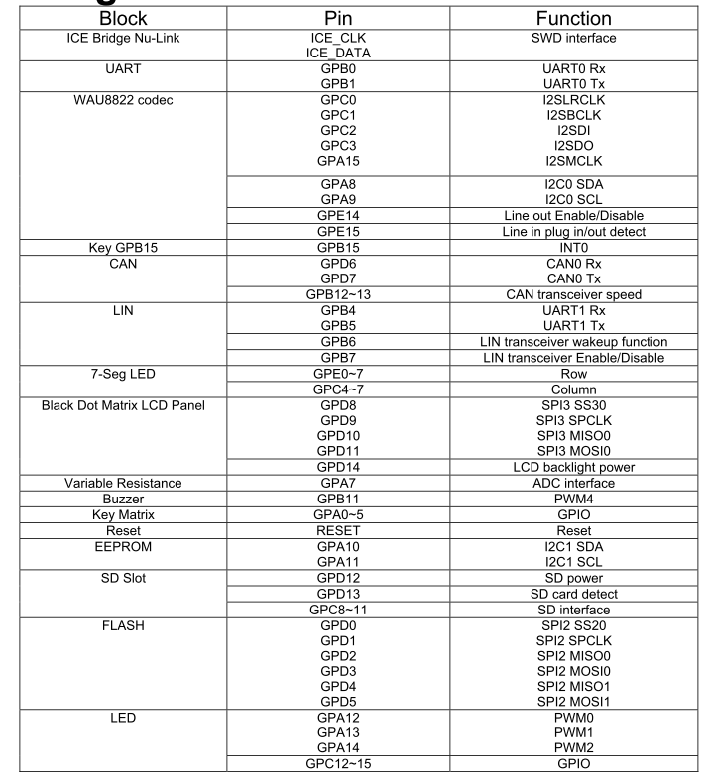

Slide 28

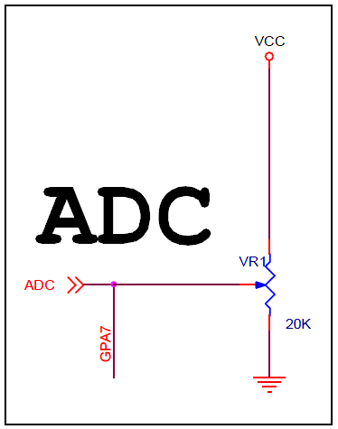


Slide 29

系統資源配置
實驗原理
  ADC介紹
  ADC動作原理
  ADC暫存器
實驗內容
實驗步驟
問題與討論

Slide 30


int32_t main (void)
{
/* Step 1. GPIO initial */
//Set input mode
GPIOA->PMD.PMD1=0;
//Disable digital input path
GPIOA->SCH|=0x00020000;
//Set ADC function
SYS->GPAMFP.ADC1=1;
/* Step 2. Enable and Select ADC clock source, and then enable ADC module */
//Select 22Mhz for ADC
SYSCLK->CLKSEL1.ADC_S = 2;
//ADC clock source = 22Mhz/2 =11Mhz;
SYSCLK->CLKDIV.ADC_N = 1;
//Enable clock source
SYSCLK->APBCLK.ADC_EN = 1;
/* Step 3. Select Operation mode */
//Enable ADC module
ADC->ADCR.ADEN = 1;
//Single end input
ADC->ADCR.DIFF = 0;
//Single mode
ADC->ADCR.ADMD = 0;

Slide 31

/* Step 4. Select ADC channel */
ADC->ADCHER.CHEN = 0x02;
/* Step 5. Enable ADC interrupt */
//clear the A/D interrupt flags for safe
ADC->ADSR.ADF =1;
ADC->ADCR.ADIE = 1;
// To enable the ADC interrtupt
NVIC_EnableIRQ(ADC_IRQn);
/* Step 6. Conversion start */
ADC->ADCR.ADST=1;
/* Step 7. wait ADC interrupt */
while(1)
{
if (ADC_INT_FLAG==0)
break;
}
}

Slide 32


int32_t main (void)
{
int32_t adc_value;
UNLOCKREG();
SYSCLK->PWRCON.XTL12M_EN = 1; //Enable 12Mhz and set HCLK->12Mhz
SYSCLK->CLKSEL0.HCLK_S = 0;
LOCKREG();
InitADC();
while(1)
{
while(ADC->ADSR.ADF==0); // ADC Flag, wait till 1 (A/DC conversion done)
ADC->ADSR.ADF=1; // write 1 to ADF is to clear the flag
adc_value=ADC->ADDR[7].RSLT; // input 12-bit ADC value
seg_display(adc_value); // display value to 7-segment display
ADC->ADCR.ADST=1; // activate next ADC sample
// 1 : conversion start // 0 : conversion stopped, ADC enter idle state
}
}

